Slide 1

Quality Assurance
What is QA? Why is it important?
Telerik Software Academy
Snejina Lazarova
Dimo Mitev
http://academy.telerik.com

Slide 2
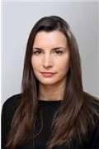
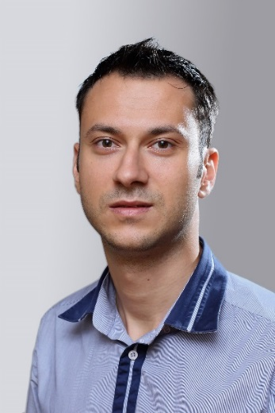
The Lectors
Snejina Lazarova
Product Manager
Business Services Team
Dimo Mitev
QA Architect
Backend Services Team

Slide 3


The Case for Software Quality
The Magic of Software
The Failure of Software
“Any sufficiently advanced technology is indistinguishable from magic.”
Arthur C. Clarke

Slide 4
What is Quality Assurance?

Slide 5

The History of Quality Assurance
How did it all start?

Slide 6

QA in Bulgaria
What about QA in Bulgaria?

Slide 7
What QA is NOT?
Notes:
Many people believe that QA is not a challenging profession - too simple tasks, does not expand personal skills, does not give room for professional growth, etc.
With this slide just start the conversation – the next two slides give more details about the variety and complexity of QA's work.

Slide 8
QA is not
all about
Clicking!
Notes:
Many people believe that QA is not a challenging profession - too simple tasks, does not expand personal skills, does not give room for professional growth, etc.
With this slide just start the conversation – the next two slides give more details about the variety and complexity of QA's work.

Slide 9


Slide 10
QA vs. Tester
Requirements
Planning
Development
Testing
Deployment
Software Quality Assurance Engineer
Software Development Lifecycle
Software Test Engineer
Notes:
Note that there is some animation used in this slide for better effect – try it out before the presentation.
The QA role in TeamPulse (I am just not sure about the case in other teams) is a good example of the expanded role of a QA Engineer throughout the whole development lifecycle – from requirements design to client support.

Slide 11

Being a Quality Assurance Engineer
What Do You Need and What Do You Get?

Slide 12

Personal Qualities Needed
Professional and personal qualities are required
Notes:
Please think of all the skills (technical and social) that you need to do your job and write down in advance some examples to give at the presentation.
The idea behind this slide is related to the "QA is not all about clicking!" slide but instead of examples of work responsibilities the focus is on the variety of skills required for a good QA professional.
I believe that an important message here is that QA is not a position that you can achieve if you are just not good enough for a developer. Accent on the fact that even a good developer does not equal a good QA!

Slide 13
How a day of a QA passes
Test case design
Testing:
stories
bugs
regression testing (done before release)
Test Automating
creating new automated tests
updating old ones
checking daily test results

Slide 14
How a day of a QA passes (2)
Writing Acceptance criteria
Maintenance of the testing environment (test infrastructure) – setting up Virtual machines, test data, etc.
Bug triaging
Reproducing and Logging bugs
Maturing upcoming stories

Slide 15
How a day of a QA passes (3)
Meetings
Daily meeting – what have we done yesterday, what are we going do today, is there something that stands in our way
Planning meeting (takes place before each iteration)
Retrospective (takes place after each iteration)
Review (presenting the delivered functionality to stakeholders, customers and cooperators)
QA meetings – sharing knowledge

Slide 16
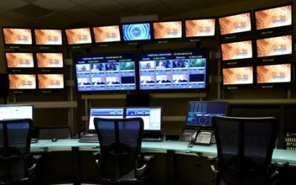
Monitoring
Monitoring of the overall process
From beginning to the end
Notes:
Explain QA as a position good for people with some organizational skills, willing to work not just with details but with the overall picture.

Slide 17



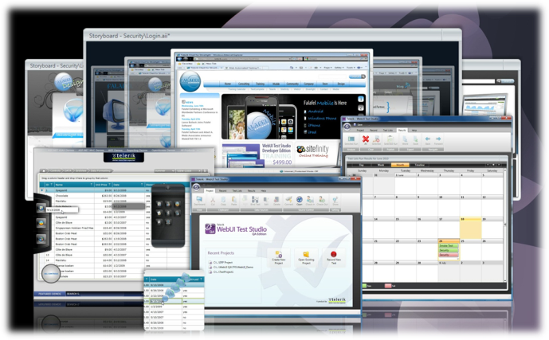




Tools
Working with variety of tools for testing, reporting, automation, performance, …

Slide 18
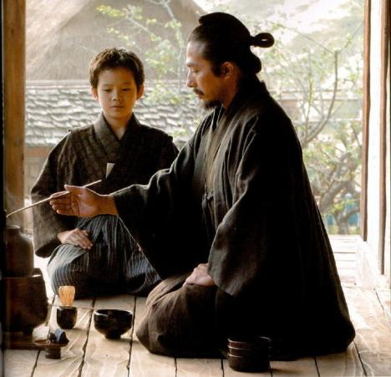

High Standards
High standard for your work and the work of others

Slide 19
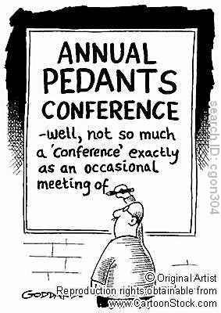
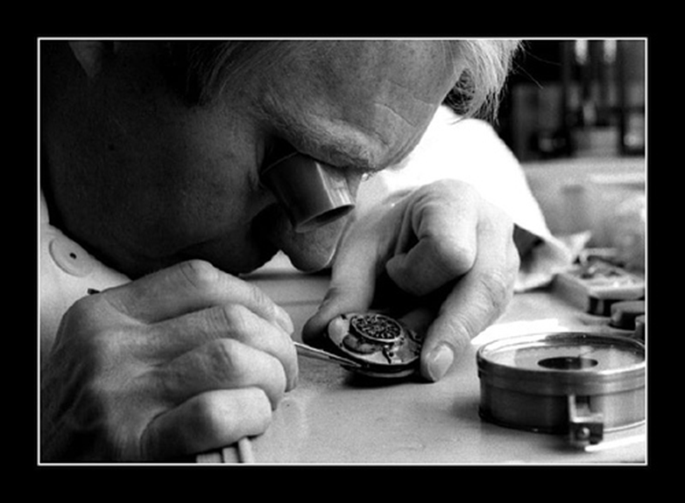
Passion for the Quality

Slide 20
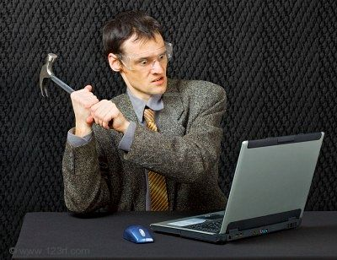
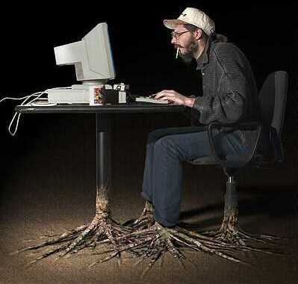
QA vs. DEV
Why QA, not Developer?
/

Slide 21

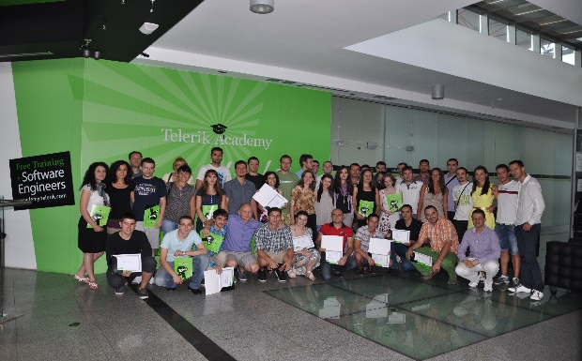
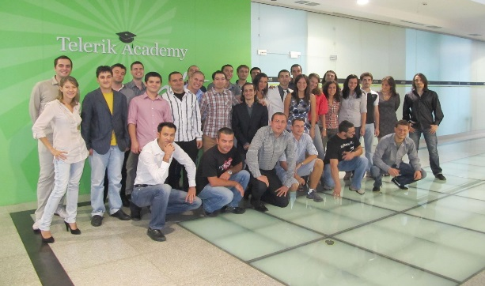
Quality Assurance Track

Slide 22
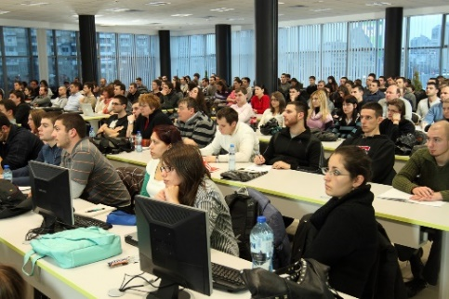
About the QA Track
Lecturers are QA Engineers working in Telerik
Time allocation
~3 months * 3 days weekly, 4 hours / day
From 16:00 to 20:00 on Monday and Wednesday
lectures and work in class with the trainer
From 15:00 to 19:00 on Friday
practical exercises, advanced topics, teamwork and other activities

Slide 23

The Challenge
Send us your masterpiece from August 18 to August 24 http://telerikacademy.com/Courses/Courses/Details/183

Slide 24
Quality Assurance
?
?
?
?
?
Questions?
?
?
?
?
?
?

